Slide 1
PREPARING AN ADDICTION STUDY PROGRAM BASED ON LEARNING OUTCOMES
Michal Miovský, Anna Vondrová
Department of Addictology
1st Faculty of Medicine
Charles University
ICUDDR Conference, Peru
21-23/7/2019

Slide 2
LEARNING OUTCOMES OF THIS PRESENTATION:
The listener will be able to:
comprehend the nature and function of learning outcomes
assess the relative merits and implications of the adoption of learning outcomes
describe the role of learning outcomes when preparing an addiction study program

Slide 3
EUROPEAN BACKGROUND
Bologna process (1999)
European Higher Education Area
Member states (48) continuously adapt their higher education systems making them more compatible and strengthening their quality assurance mechanisms
Tools:
Qualification frameworks
Credit transfer (ECTS)
Quality assurance
Diploma supplement
Learning outcomes

Slide 4
LEARNING OUTCOMES - DEFINITION
No precise agreement about the term
statements of what a learner is expected to know, understand and/or be able to demonstrate at the end of a period of learning
explicit statements about the outcomes of learning – the results of learning
mixture of knowledge, skills, abilities, attitudes and understanding that an individual will attain as a result of his or her successful engagement in a particular set of higher education experiences
methodological approach for the expression and description of the curriculum (modules, units and qualifications) and levels, cycles,…

Slide 5
AIMS, GOALS, OBJECTIVES…
AIMS /GOALS- broad general statements of the teaching intention
“to provide a general introduction to the history of the Harm Reduction approach”
OBJECTIVES - specific statements of teaching intention
“students would understand the impacts and effects of addiction risk behaviours“
👉 teacher-centred approach

Slide 6
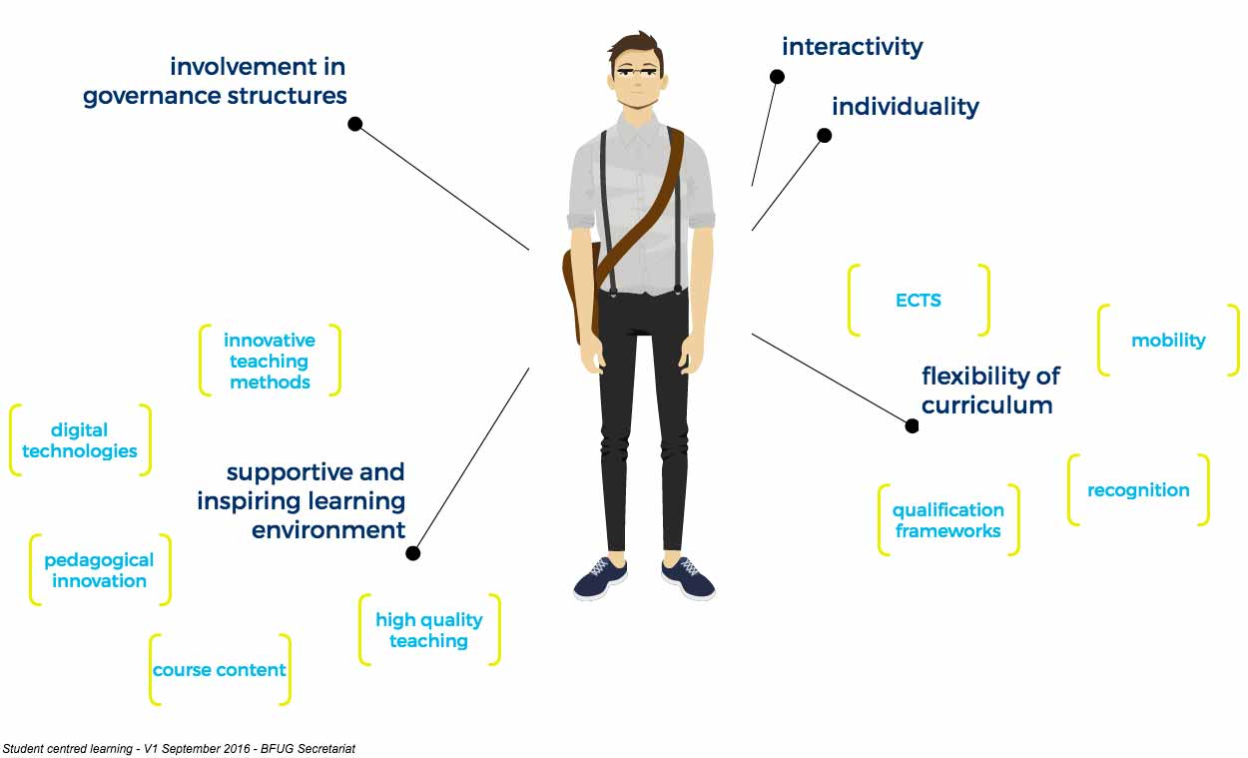
👉 student-centred approach
EHEA, 2019

Slide 7
COMPETENCY MODEL
„CBE is defined as an outcome-based approach to education that incorporates modes of instructional delivery and assessment efforts designed to evaluate mastery of learning by students through their demonstration of the knowledge, attitudes, values, skills, and behaviors required for the degree sought.“ (Gervais, 2016)
competence is used to represent a combination of attributes in terms of knowledge and its application, skills, responsibilities and attitudes and an attempt is made to describe the extent to which a person is capable of performing them

Slide 8
THREE LEVELS OF APPLICATION
the local level of the individual higher education institution (for course units/modules, programmes of study and qualifications)
the national level (for qualifications frameworks and quality assurance regimes)
the international level (for wider recognition and transparency purposes)

Slide 9
OUR EXPERIENCE

Slide 10
OUR EXPERIENCE
Analysis of the study program
Reconstructing the study program with UPC implementation
Creating an international study program combining UPC/UTC, Prague model and Competency model

Slide 11
1. Analysis of the study program
Background: Non-transparent, chaotic description of the study program
Aim: To formulate learning outcomes for the addiction study program
Methods: Content analysis of available resources
Results: Due to the programs characteristics, 9 areas were identifies and formulated into learning outcomes. Each area has seperately formulated knowledge and skills gained after graduating.
Conclusion: Learning outcomes were formulated and areas were identified missing. There is a need to discuss and continue in the process.

Slide 12
1. Analysis of the study program – example of the LO
Ten main areas were identified: health care, research, addiction specialization, special target groups in addictology, law, social-psychology, medicine and nursing, counseling and therapeutic skills, management.
Medicine and Nursing
The student has knowledge and skills in the fields of psychiatry, pediatrics, neuroscience and clinical toxicology. He is able to use diagnostic classification manuals, understands the functioning of the human nervous system and can describe the effects of psychotherapy in relation to it. He independently performs selected nursing activities, particularly in the area of ​​drug testing and related counseling.
Knowledge: ability to explain and characterize the importance of diagnostic manuals and categories of diagnosis and to identify and characterize major groups of psychological disorders with regard to diagnostic manuals (ICD 10, DSM IV), more specifically, groups of disorders caused by the use of addictive substances
Skill: ability to recognize and describe a possible psychiatric illness in a patient and to argue for appropriate interventions

Slide 13
2. Reconstructing the study program with UPC implementation
Background: Need to increase the number of prevention courses and to broaden the prevention learning outcomes
Aim: To formulate prevention learning outcomes for the addiction study program
Methods: Content analysis of available resources, implementation of UPC
Results: Definition of prevention learning outcomes
Conclusion: Prevention learning outcomes were formulated. There is a need to discuss and continue in the proces due to teachers and their capacities

Slide 14
2. Reconstructing the study program with UPC implementation
BA prevention courses
Old:
Primary drug prevention
Primary prevention programs in practice
New:
Introduction to prevention science
School prevention
Prevention in family conext
Prevention in workplace
Prevention LO were spread into many other courses (Working with families, Harm reduction courses, Pediatrics, Pedagogy,…) – a new formulation enabled to strengthen the prevention branch.

Slide 15
2. Reconstructing the study program with UPC implementation
MA prevention courses
New:
Environmental iprevention and public health interventions
Media and ICT prevention
Community-based prevention and implementation systems
Monitoring and evaluation of prevention interventions and policies
Prevention LO were spread into many other courses (Public Health courses, Drug policy, Methodology,…) – a new formulation enabled to strengthen the prevention branch.

Slide 16
3. Creating an international study program combining UPC/UTC, Prague model and Competency model
Challenging work – „completely new“ program
The need to find a new way of thinking
Learning outcomes – their formulation helped us to find what is important
First step – formulating competencies and identifying relevant topics
Second step – making a graph
Third step- identify courses and build the timeline
Fourth step – discuss and fill in the documentation

Slide 17
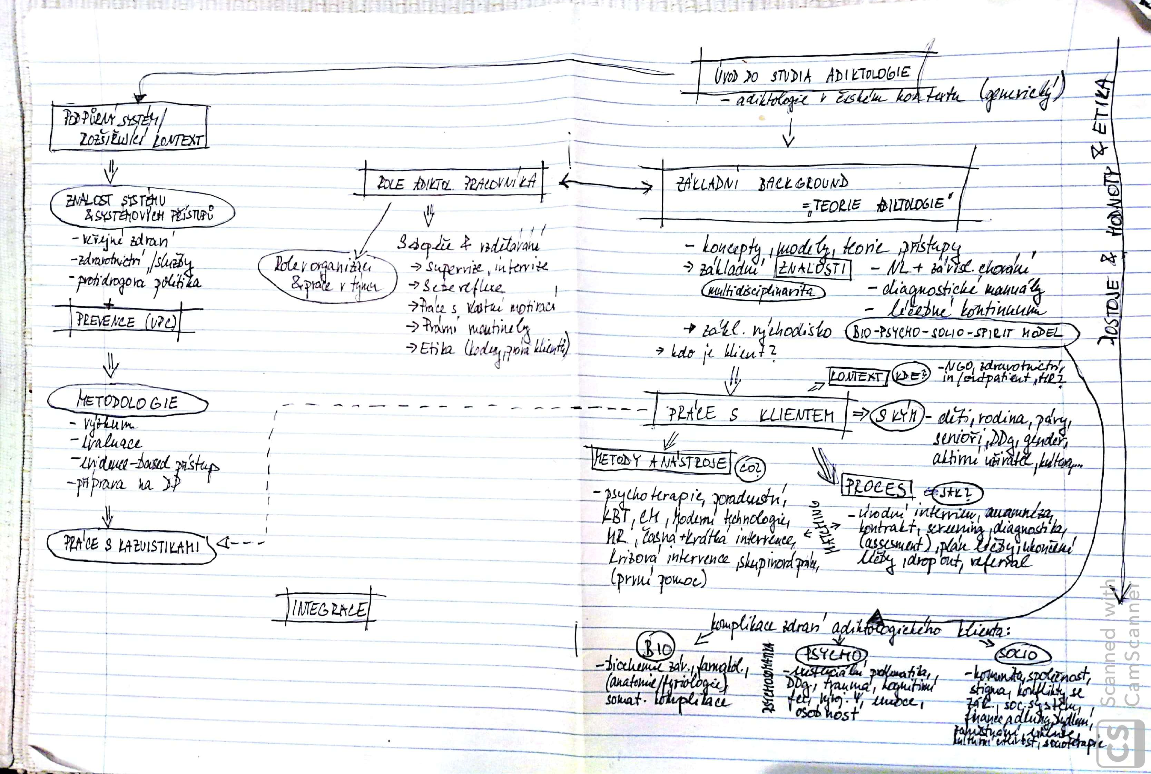
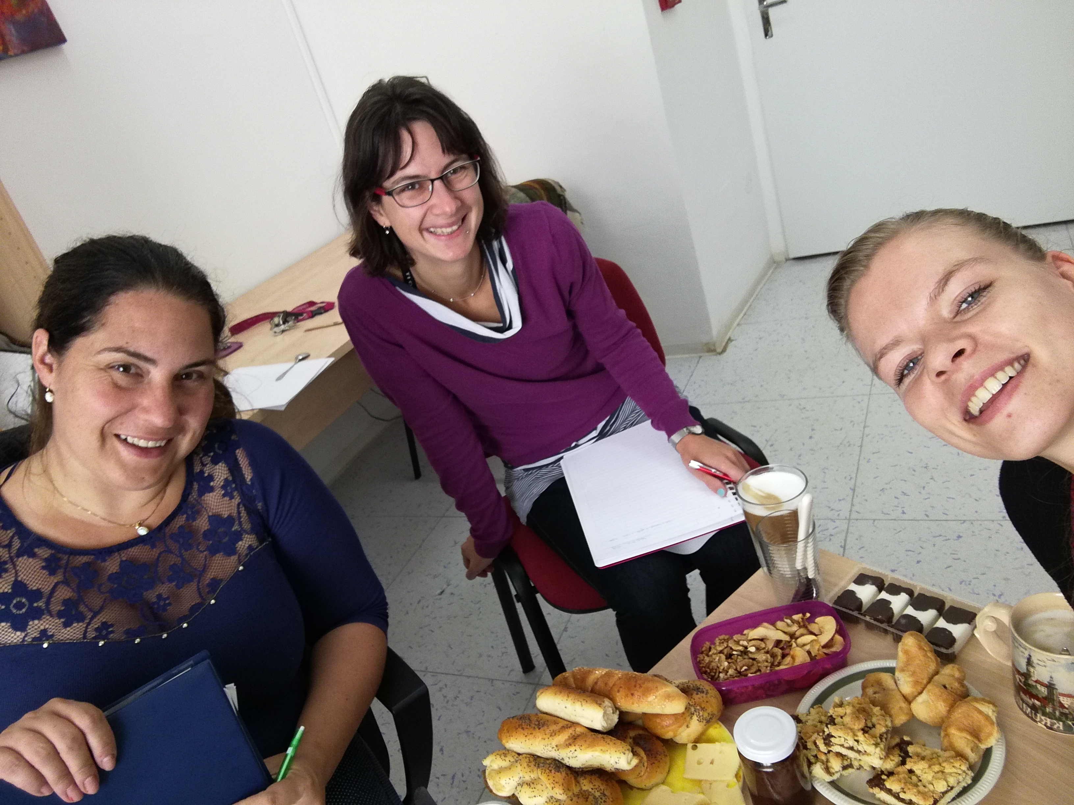
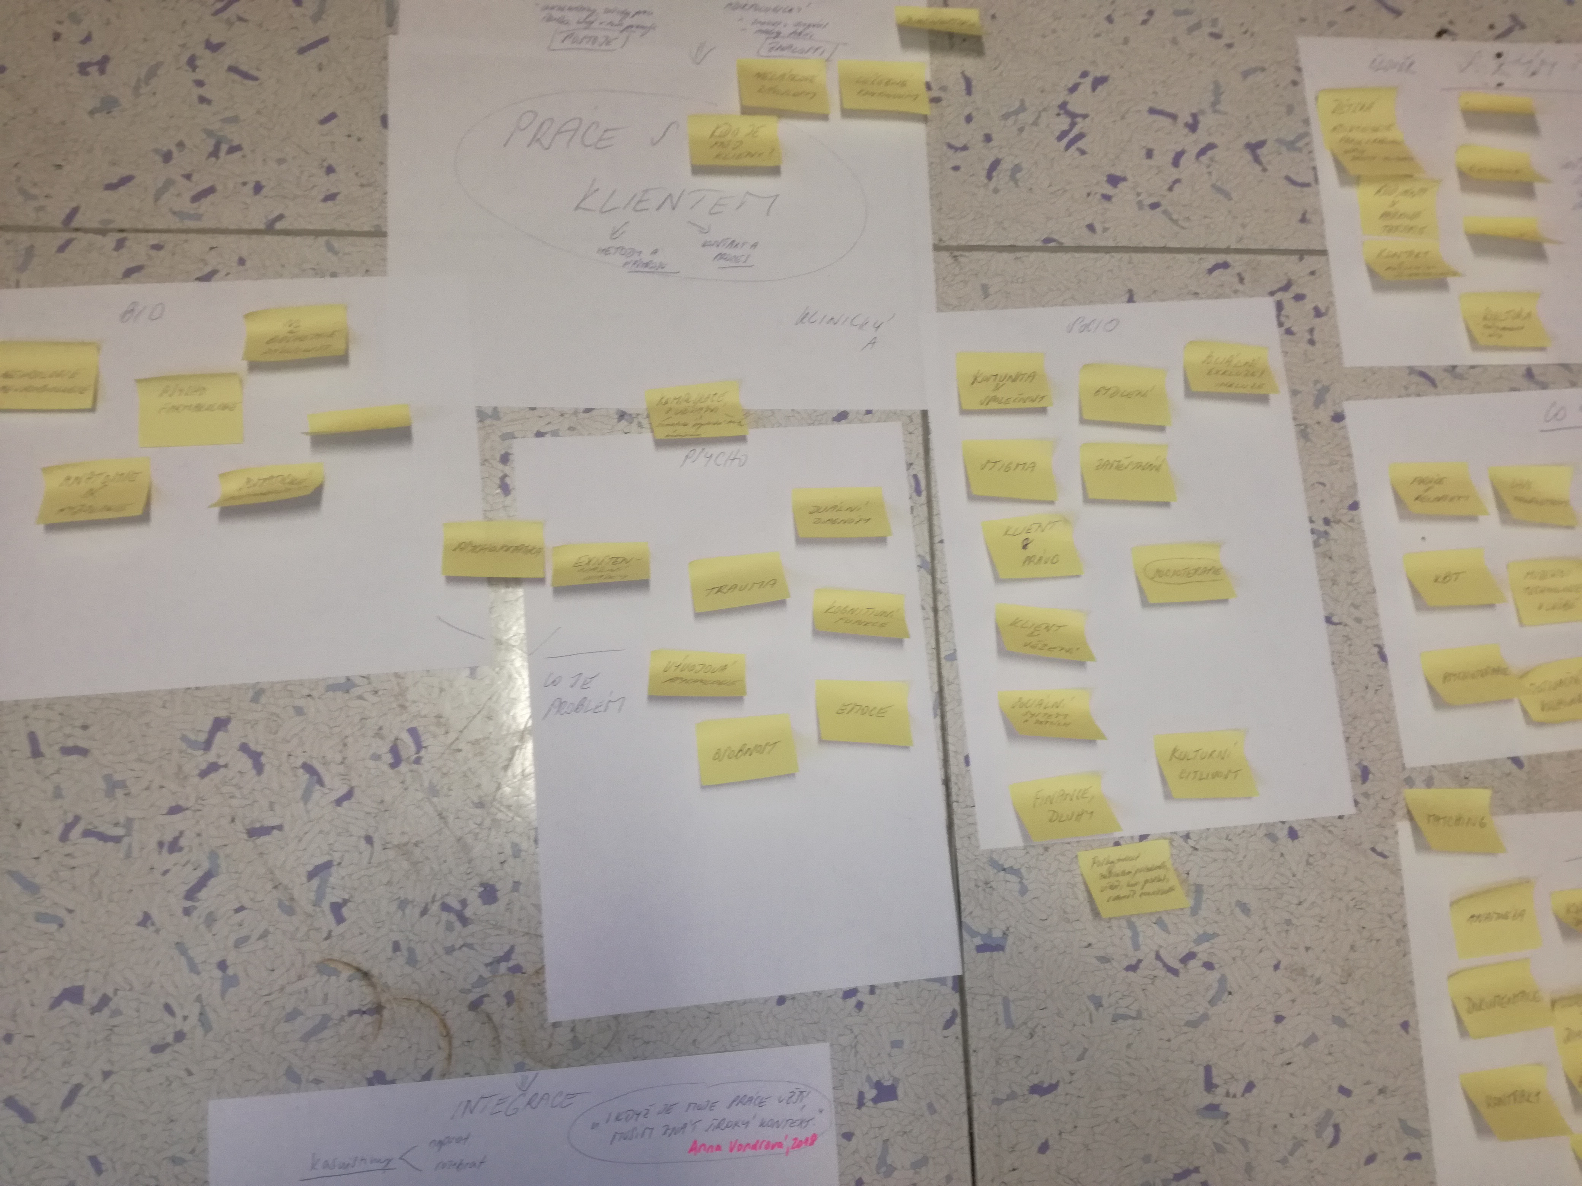
1. and 2. step – brainstorm, smile, and make graphs

Slide 18
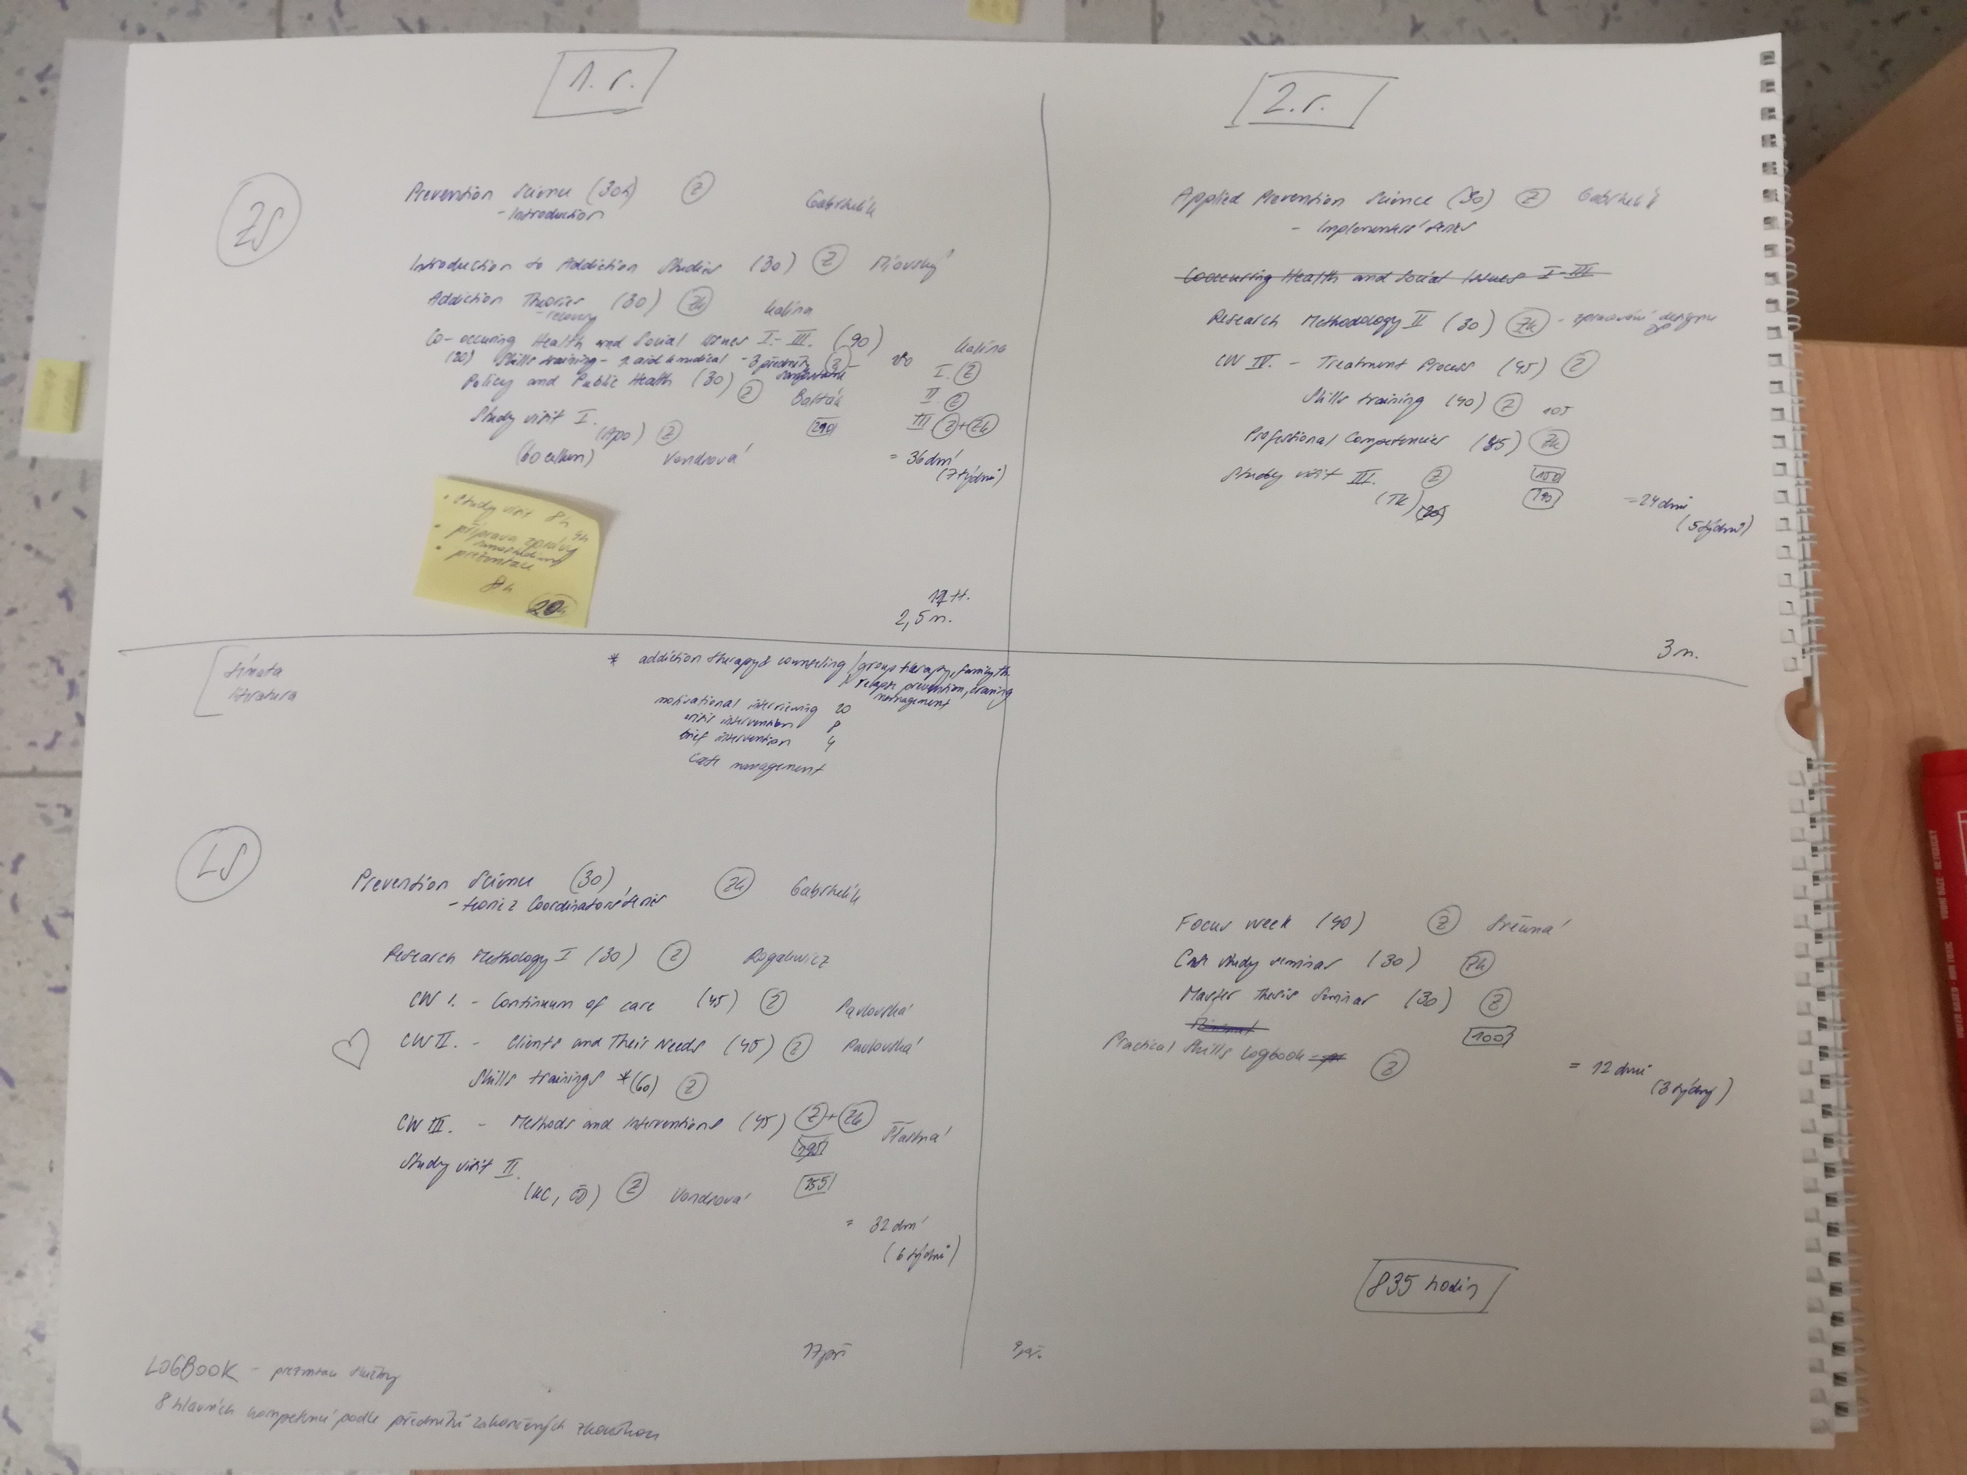
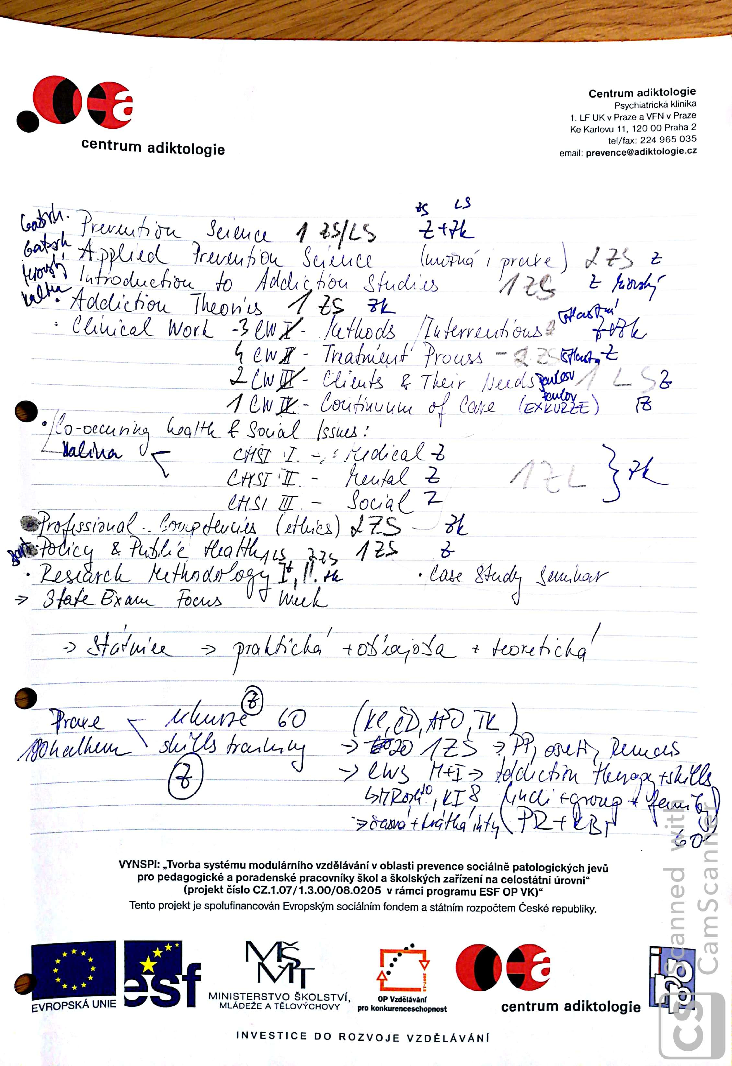
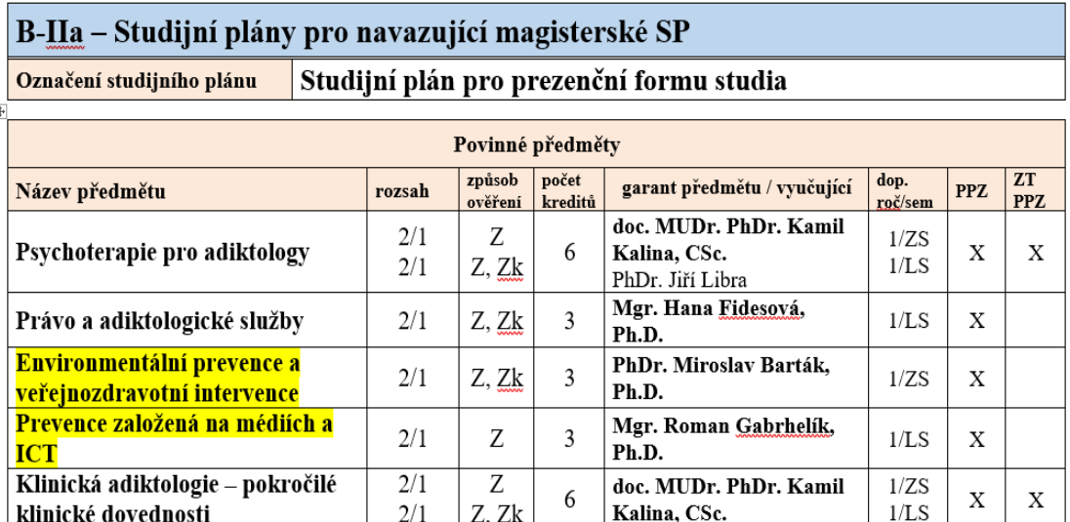
3. and 4. step – identify courses, discuss, fill in documentation

Slide 19
SUMMARY
Learning outcomes are a tool, which helps formulate what, who and how do we teach
LOs help create the design of a program
Due to the diversity of addiction study programs all over the world, LOs bring transparency, understanding, precision
LOs help increase quality of the study programs
LOs help recognition of the study program in the context of higher education and the labor market

Slide 20
REFERENCES
Gervais, J. (2016). The operational definition of competency-­based education. The Journal of Competency-Based Education, 1(2), 98–106. doi: 10.1002/cbe2.1011
Adam, S.F. (2006). An introduction to learning outcomes A consideration of the nature , function and position of learning outcomes in the creation of the European Higher Education Area. Online: https://is.muni.cz/do/1499/metodika/rozvoj/kvalita/AdamHLP.pdf
Kennedy, D. (2006). Writing and using learning outcomes: a practical guide, Cork, University College Cork. Online: http://hdl.handle.net/10468/1613
www.ehea.info

Slide 21
THANK YOU!
ANY QUESTIONS?
anna.vondrova@lf1.cuni.cz

